Slide 1

Traits introduced into PHP 5.4
By Min Thet Naing

Slide 2

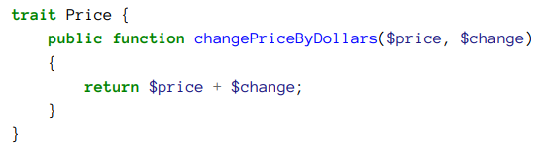
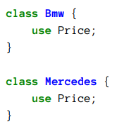
By Min Thet Naing

Slide 3
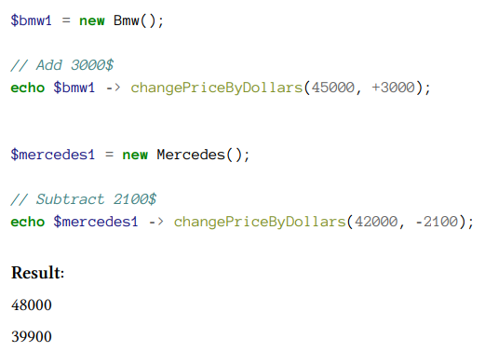
By Min Thet Naing

Slide 4
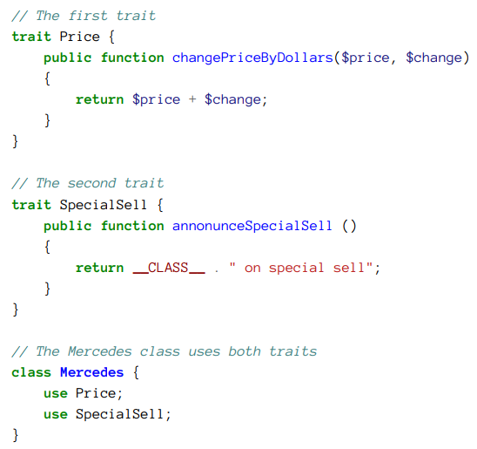
A class can use more than one trait
By Min Thet Naing

Slide 5
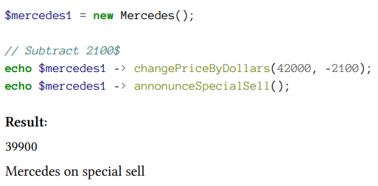
By Min Thet Naing

Slide 6
Trait differ from Inheritance
Horizontal inheritance
In a trait it is possible to put concrete (real) methods, abstract methods, properties and even constants
The same class can use more than one trait
Traits do not respect the visibility scope
By Min Thet Naing

Slide 7
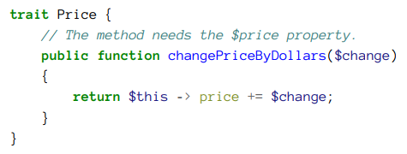
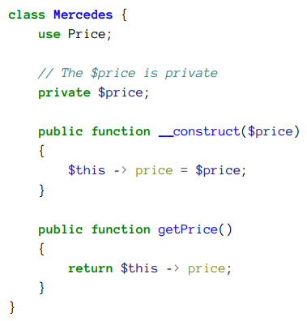
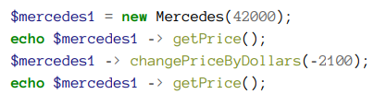

By Min Thet Naing

